Slide 1

​Cross-Section Measurements for Novel Medical Radionuclides at UCB/LBNL: The Challenge of "Simple" Experiments
Andrew S. Voyles
12 February 2018 – NE Department Colloquium

Slide 2
Overview
Background & history of nuclear medicine
⁶⁴Cu and ⁴⁷Sc (n,p) cross-section measurements
Stacked-target charged particle excitation functions
Path forward

Slide 3
Background & History of Nuclear Medicine
___________________________

Slide 4
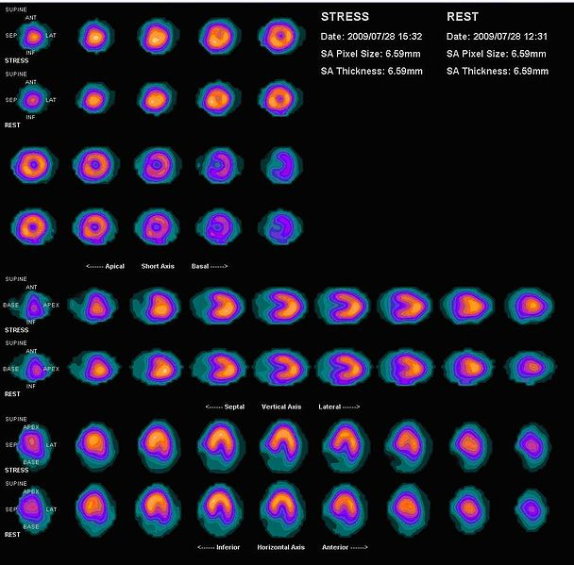
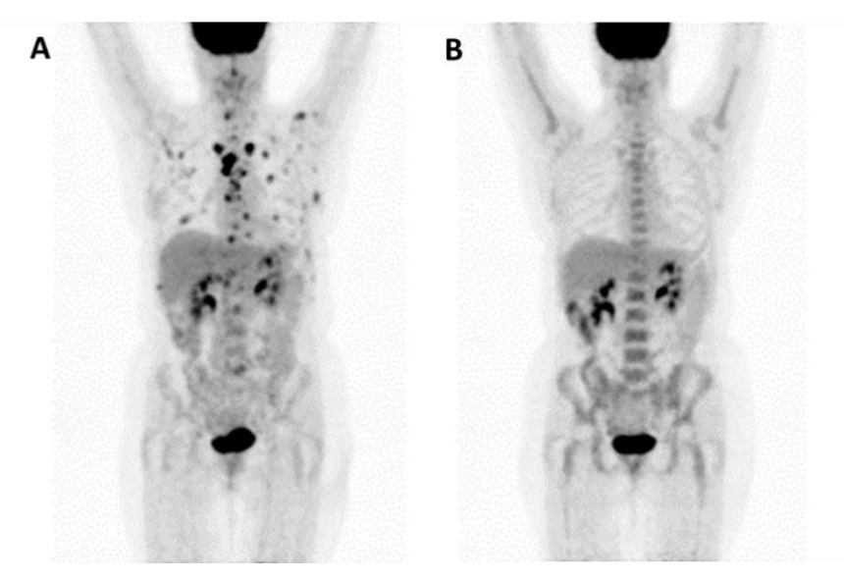
Nuclear Medicine in the U.S.
Nearly 17M procedures performed annually in the US
Major isotopes in modern clinical nuclear medicine:
^{99m}Tc
Diagnostic isotope for cardiac, renal, lung function, tumor imaging
Produced as fission product in thermal reactors
Costs per 10-mCi dose ranges $20-40¹
¹⁸F
PET isotope used for metabolic tumor & metastasis imaging
Produced by K~15 medical cyclotrons via ¹⁸O(p,n)¹⁸F
Costs per 5-mCi dose ranges $400-800²
¹³¹I
β-therapy isotope used for treatment of cancers, including thyroid and neuroendocrine
Produced as fission product in thermal reactors
Costs per 200-mCi dose approximately $200³
[1] C. Whipple and S. Larson, Medical Isotope Production Without Highly Enriched Uranium, 2009.
[2] United States Government Accountability Office and U.S. General Accounting Office, Report GAO-08-452,2008.
[3] A. N. Khalid, et al, “Arch. Otolaryngol. Neck Surg., vol. 132, no. 3, pp. 244–250, 2006.
Notes:
Dates back to 1946 – ¹⁴C production at ORNL Graphite Reactor¹
Per the US Society of Nuclear Medicine & Molecular Imaging, approximately 17 million nuclear medicine (diagnostic and therapeutic, on top of another ~130M of radiology) procedures are performed in the US annually
Nearly 1 in 20 people!
Annual industry estimated at $2.4 B

Slide 5
Nuclear Medicine in the U.S.
Established medical radioisotopes face several challenges:
Non-ideal decay properties for desired application
Extra dose
Extra range
Curtailment of production facilities (^{99m}Tc)
Thermal reactor issues
Low yield
Difficult radiochemical purification
Feasibility & deployability
Why do we keep doing this?
How can we improve this?

Slide 6
Nuclear Medicine in the U.S.
Established medical radioisotopes face several challenges:
Non-ideal decay properties for desired application
Extra dose
Extra range
Curtailment of production facilities (^{99m}Tc)
Thermal reactor issues
Low yield
Difficult radiochemical purification
Feasibility & deployability
Novel isotopes…
…and new paradigms for isotope production!
Why do we keep doing this?
How can we improve this?

Slide 7
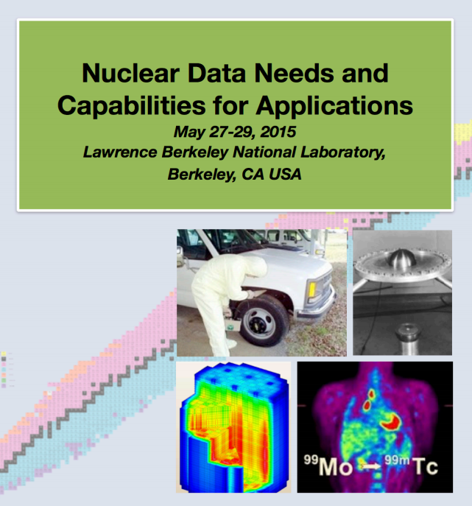
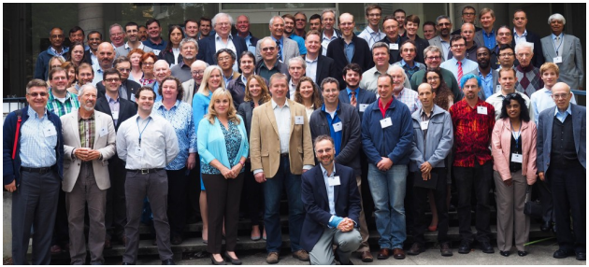
Some perspective
S.M. Qaim
Notes:
Dr Qaim - plenary speaker and instigator of priority isotopes

Slide 8
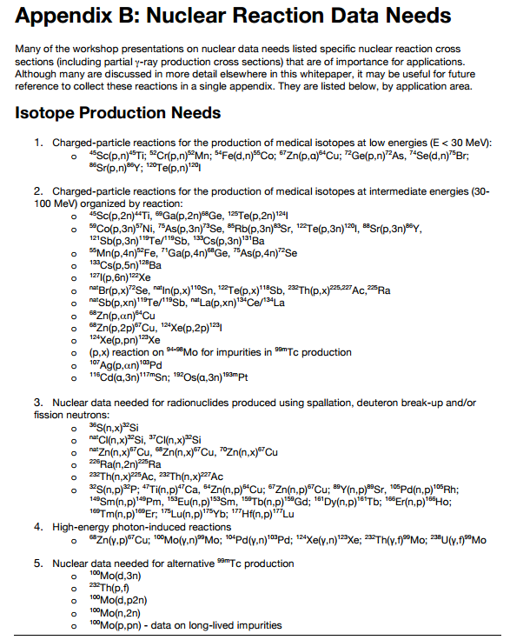
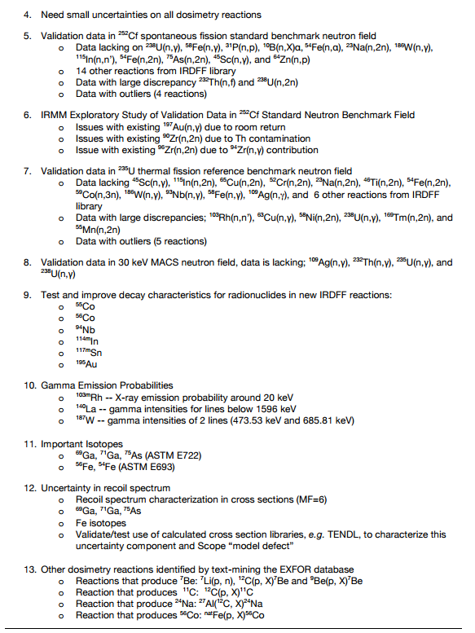
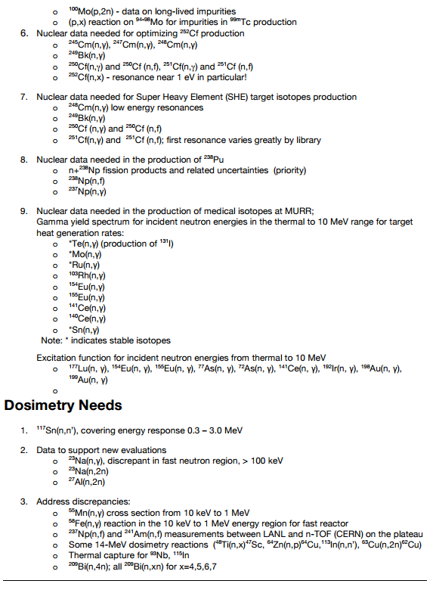
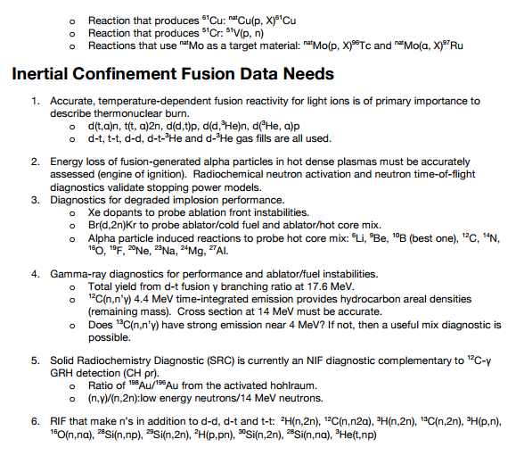
Some perspective
Highlight from WTTC 2016: ⁵⁴Fe(p,α)⁵¹Mn
NDNCA Whitepaper available at http://bang.berkeley.edu/events/ndnca/whitepaper/

Slide 9
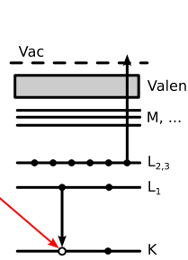
Some perspective
Emerging trends for next-generation (targeted & personalized) nuclear medicine:
Targeted alpha therapy (5-10 MeV)
40-80 μm range → single cell
Targeted Auger therapy (20 eV – 1 keV)
1 nm – 2 μm → cellular nucleus
Theranostic medicine
Simultaneous imaging and therapy
Notes:
DOE-NP has long-range plan to pursue development of these emerging isotopes

Slide 10
Overview
Ongoing targeted experimental campaign to address these needs:
(n,p) production cross sections – UCB
Stacked-target charged particle excitation functions
Low energy – LBNL
Moderate energy – LANL
Bonus – spin distribution of excited nuclear states

Slide 11
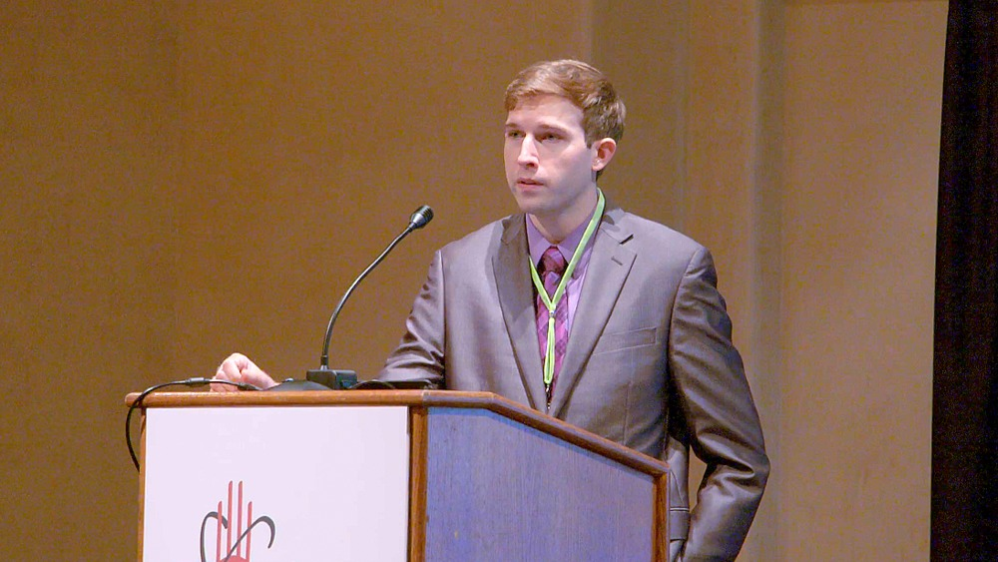

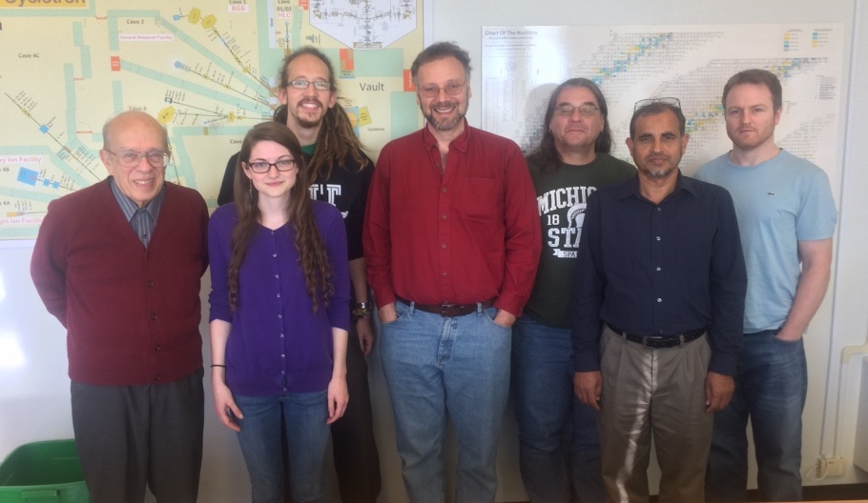


The LBNL/UCB Bay Area Nuclear Data (BAND) Group*…
E. Browne
A. Springer
J. Batchelder
A. Hurst
J. Morrell
A. Voyles
L. Kirsch
E. Matthews
A. Lewis
L. Bernstein
M. Basunia
Our goal is to address the data needs of the applied nuclear science community while training the next generation of nuclear scientists and engineers in the process
UCB Nuclear Engineering students lead our experimental program
Notes:
We do this by bringing together young…and other…scientists and engineers

Slide 12
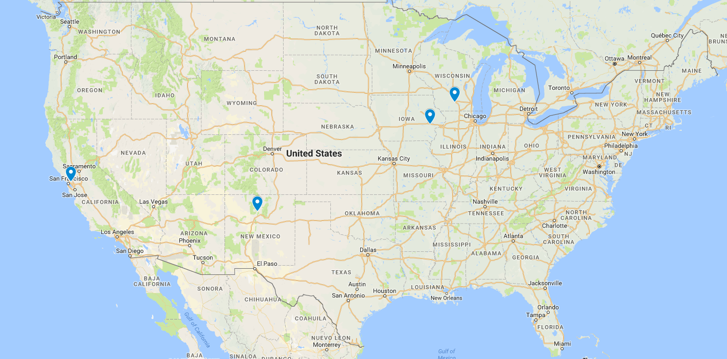
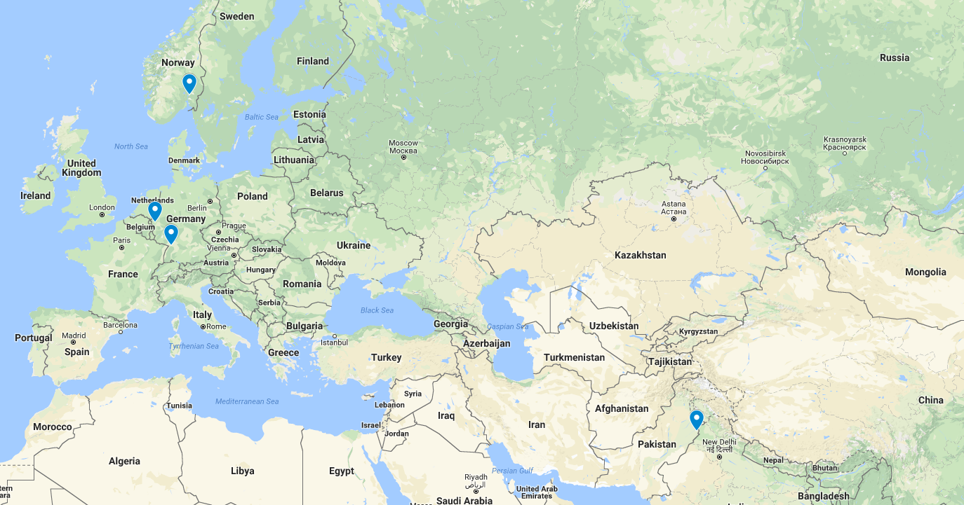
University of Wisconsin - Madison
University of Iowa
UC Berkeley
LBNL
LLNL
LANL
University of Oslo
Forschungszentrum Jülich
Karlsruhe Institute of Technology
University of Lahore

Slide 13
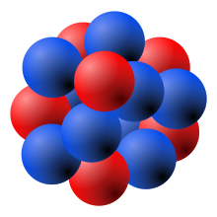
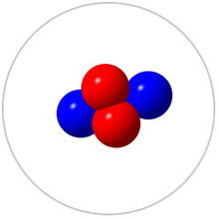
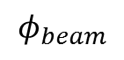
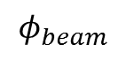
A simple picture of cross-sections…
$$φ_{beam}$$
Proper characterization of is often the largest source of uncertainty in precision measurements
$$φ_{beam}$$
Notes:
Many XS measurements fail to report an energy uncertainty!

Slide 14
⁶⁴Cu and ⁴⁷Sc (n,p) Cross-Section Measurements
___________________________

Slide 15
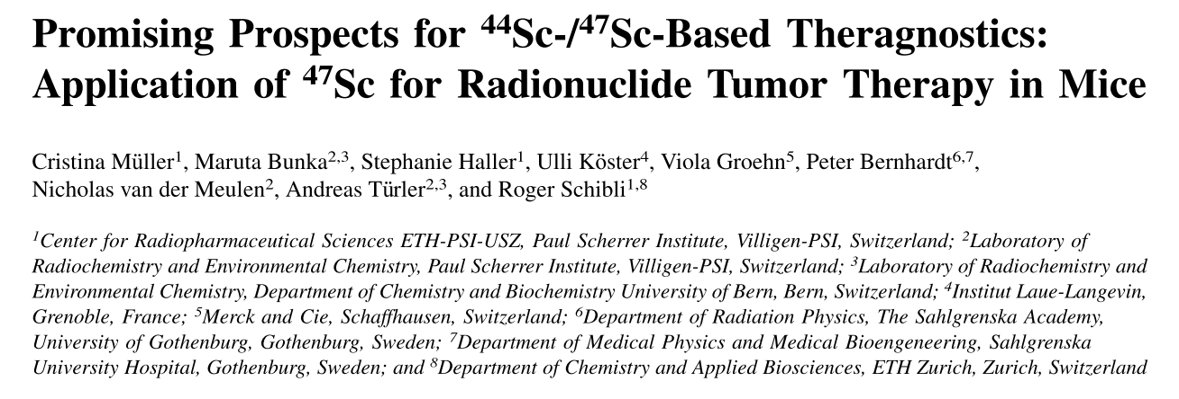
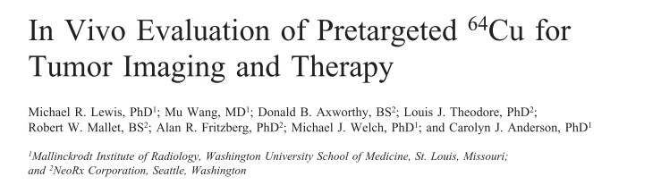
Medical Applications
Emerging medical radionuclides
⁶⁴Cu (t_{1/2} = 12.7 hr) – 61% β⁺ to ⁶⁴Ni, 39% β⁻ to ⁶⁴Zn
⁴⁷Sc (t_{1/2} = 3.35 d) – β⁻ to ⁴⁷Ti, with 159-keV γ

Slide 16
Why (n,p) via DD neutrons?
Advantages over thermal reactors:
Co-production of many unwanted activities via (n,γ)
Far cheaper startup costs, no proliferation concerns
Advantages over DT neutrons:
14-15 MeV DT neutrons open up unwanted (n,pxn) channels, contaminating the desired product
No tritium handling concerns
2-3 MeV DD neutrons are ideal for (n,p) and (n,α) production, but often suffer from fairly low flux, and poor nuclear data

Slide 17
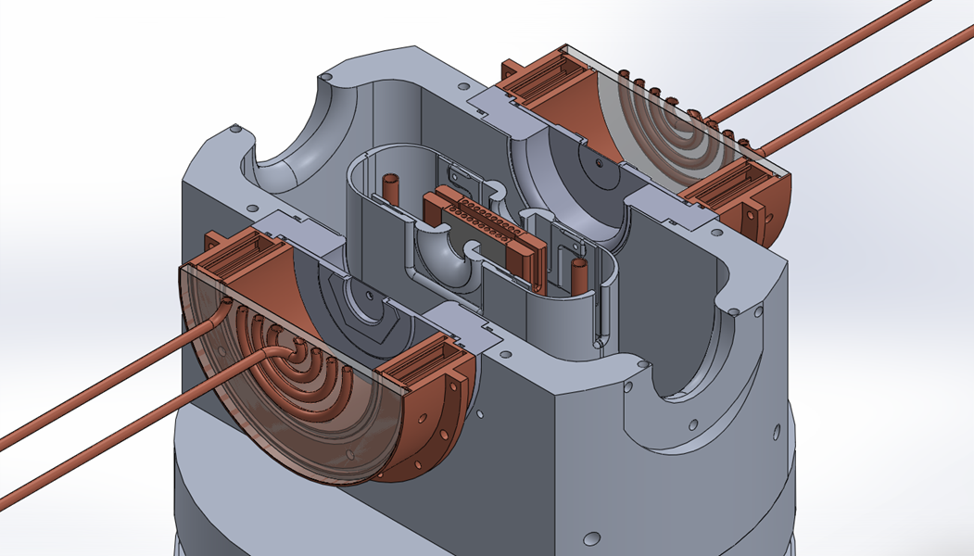
The UC Berkeley High Flux Neutron Generator
2.45 MeV neutrons, 10⁷ n/s/cm²
Extraction Plate: 5mm diameter
D Plasma
100kV
RF
DD Fusion
D beam
1-1000mA
Deuterium Gas
H₂O

Slide 18
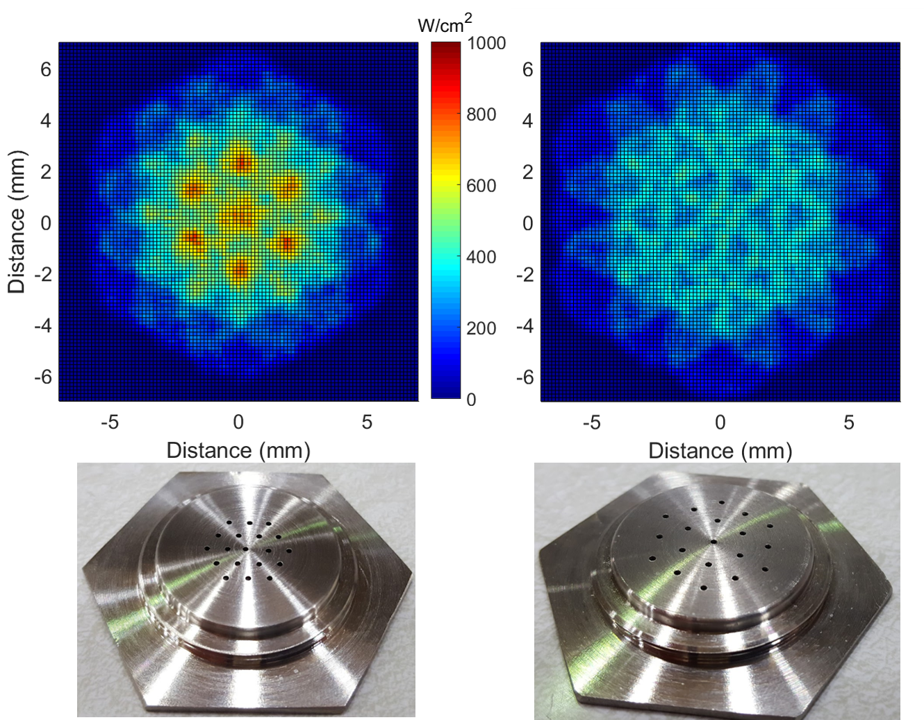
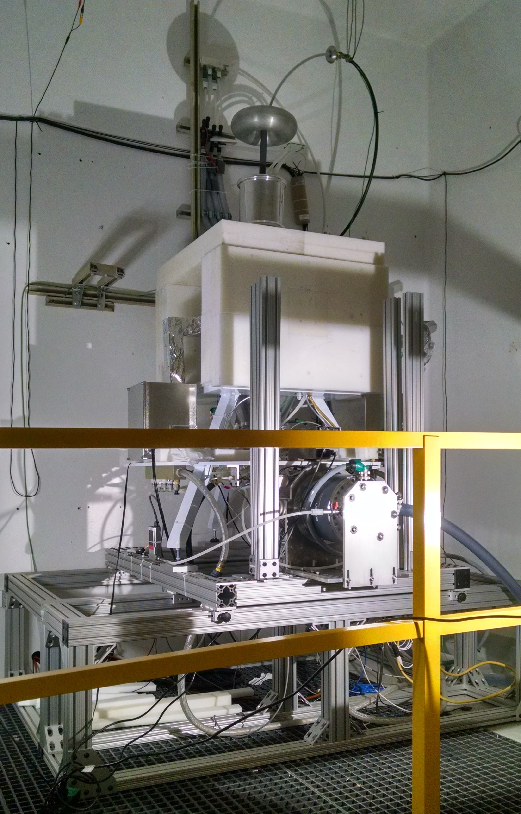
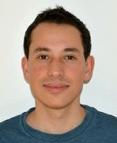
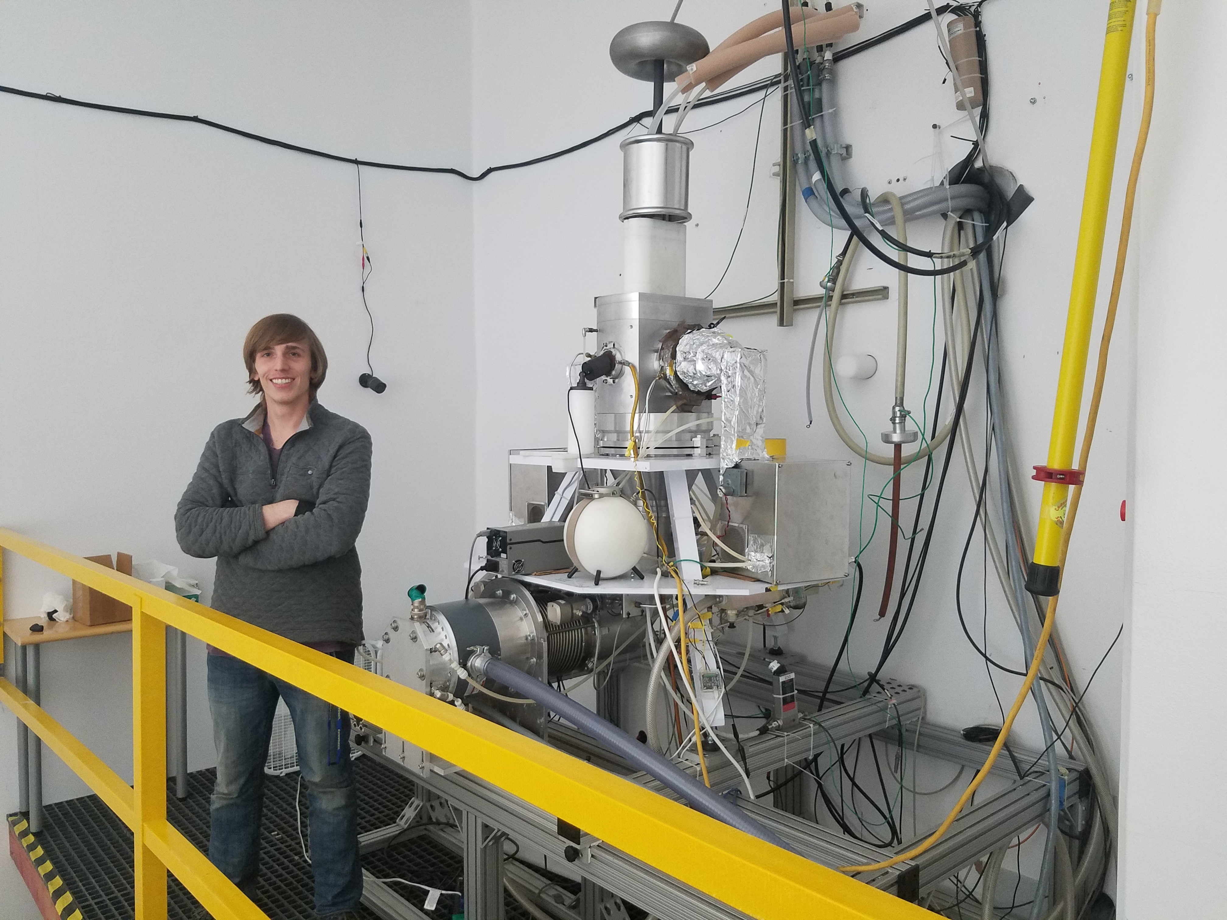
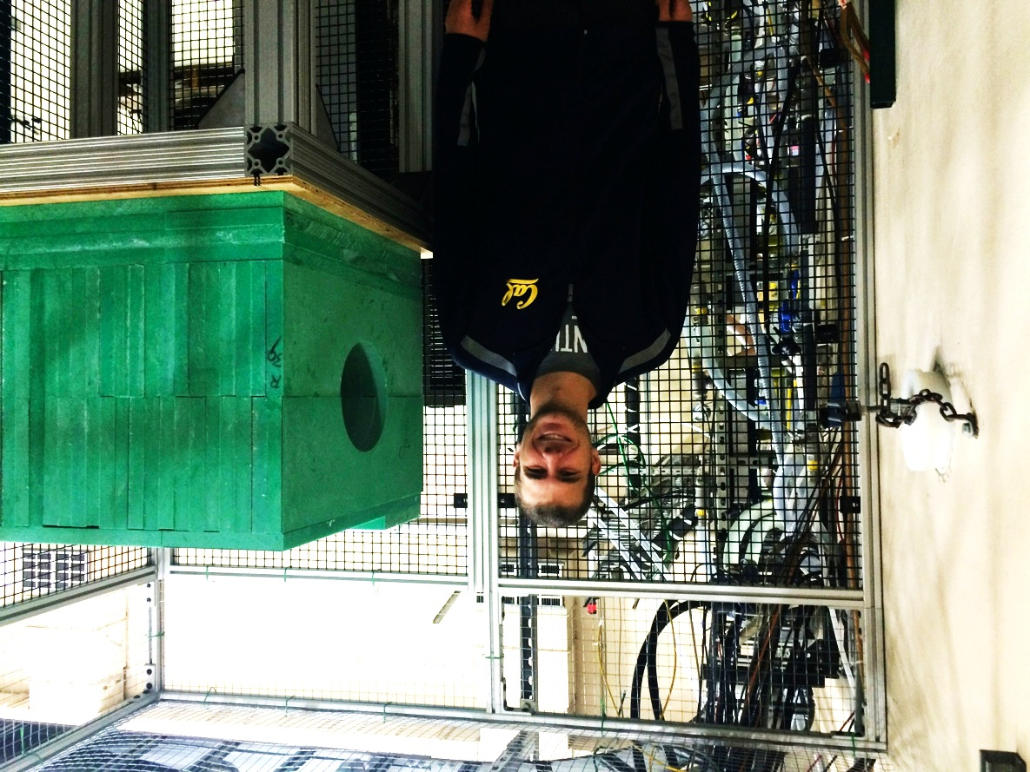
M. Unzueta
3 generations of our “real neutron source”
C. Waltz
J. Morrell

Slide 19
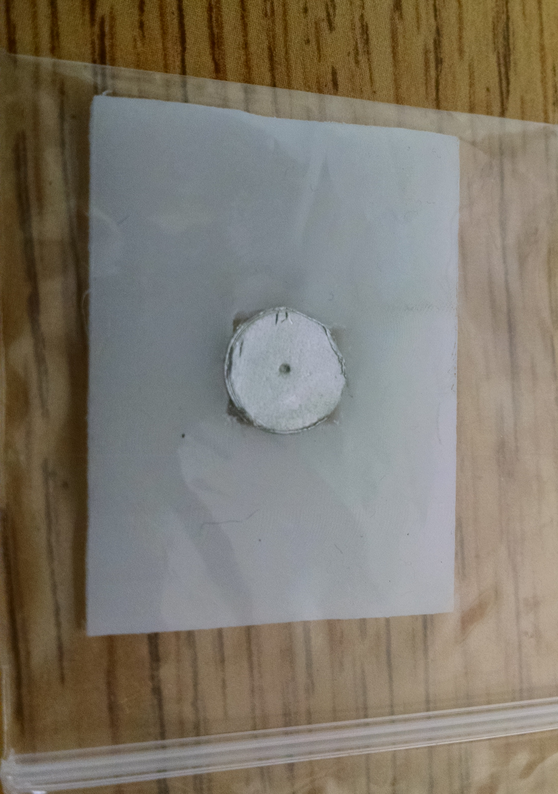
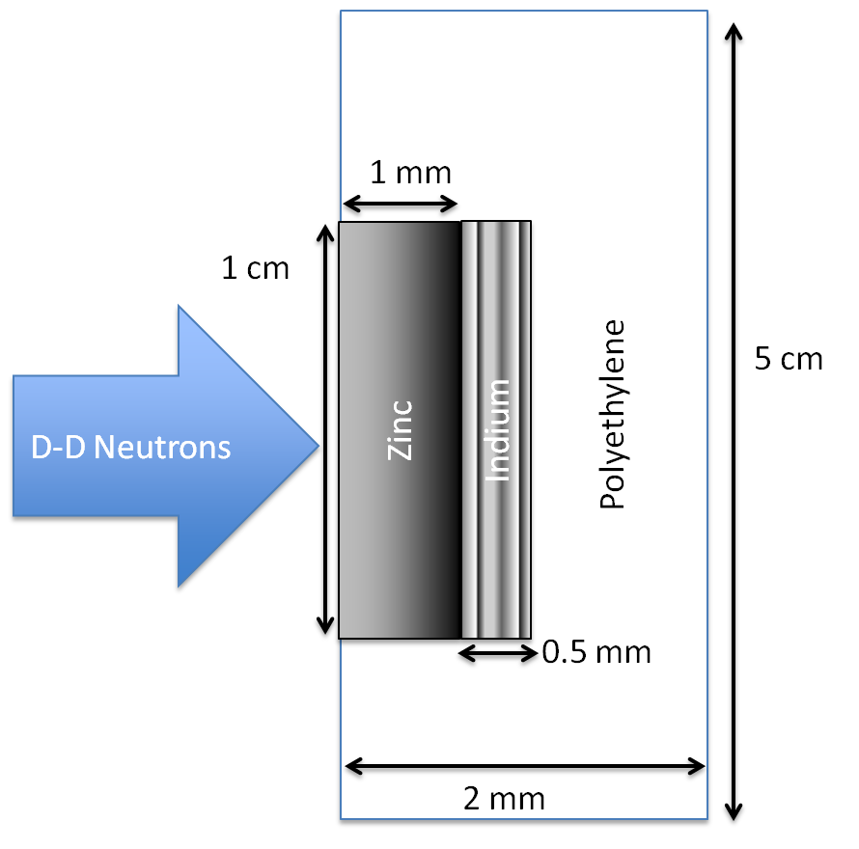
The UC Berkeley High Flux Neutron Generator
Dosimetry: IRDFF ^{113/115}In(n,n’)^{113m/115m}In standards
Foils Used | Metal Purity | Abundance (a/o) | Foil Density (mg/cm²)
^{nat}In | > 99.999% | ¹¹³In (4.29%), ¹¹⁵In (95.71%) | 365.5
^{nat}Zn | > 99.99% | ⁶⁴Zn (49.17%) | 714.1
^{nat}Ti | 99.999% | ⁴⁷Ti (7.44%) | 450.6
Notes:
64Zn - 49.17%, 66Zn – 27.73%, 67Zn – 4.04%, 68Zn – 18.45%
46Ti – 8.25%, 47Ti – 7.44%, 48Ti – 73.72%, 49Ti – 5.41%, 50Ti – 5.18%

Slide 20
The UC Berkeley High Flux Neutron Generator
Zn
Zn
In
In

Slide 21
Relative Activation Measurements

Slide 22
Relative Activation Measurements
t_{1/2} = 4.519 ± 0.016 h
(Accepted = 4.486 h)
χ² /ν = 1.653
t_{1/2} = 12.10 ± 0.85 h
(Accepted = 12.701 h)
χ² /ν = 1.743
Notes:
Producing O(10 kBq), with dead time < 5%

Slide 23
Neutron Energy Spread
n
n
θ
n
Titanium
d
D
n

Slide 24
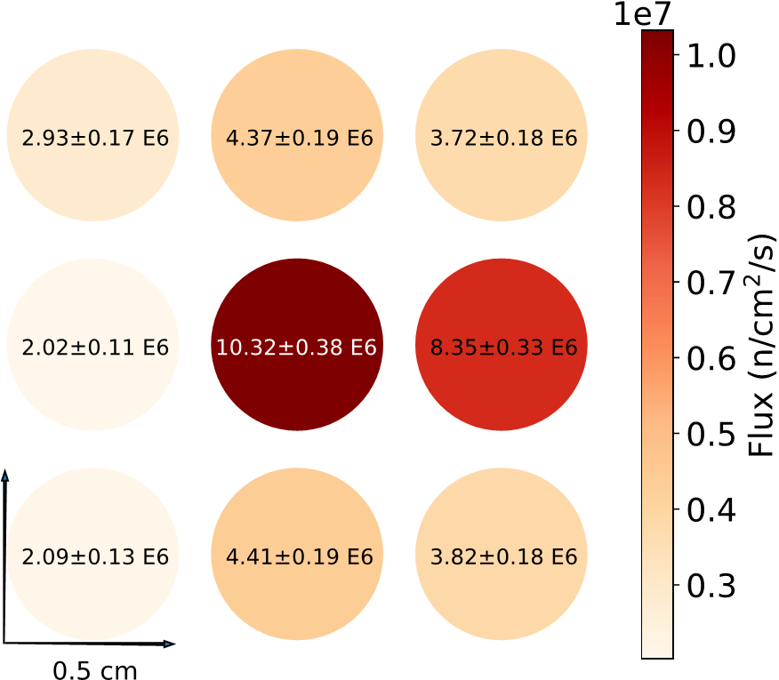
Neutron Energy Spread
Neutron Energy Spread
Relative fluxes as seen by a 3 x 3 array of 0.5-cm diameter indium foils. The central foil corresponds to the location in which target and monitor
foils were mounted during the cross section measurements, verifying
that the beam is centered on the middle of mounted foils

Slide 25
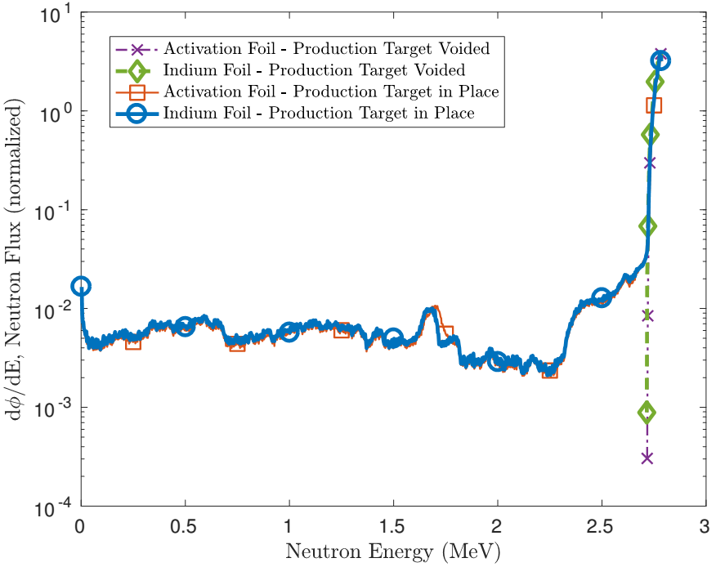
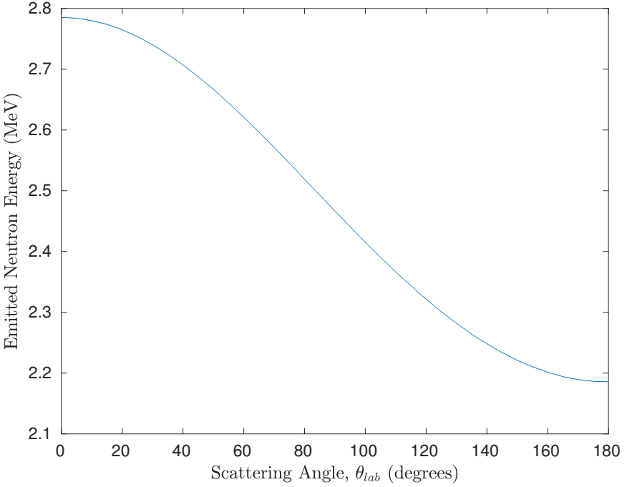
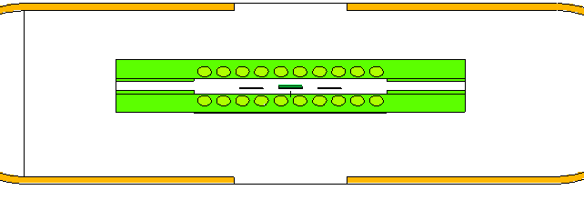
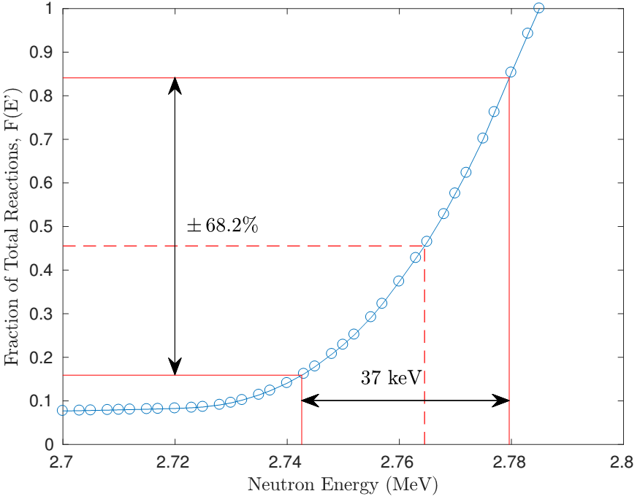
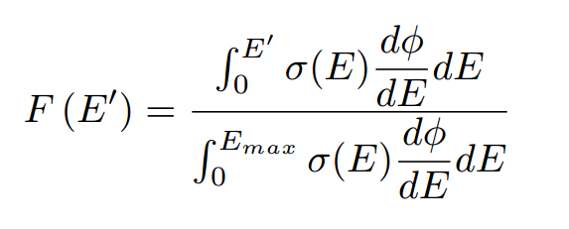
Neutron Energy Spread
Neutron Energy Spread
H. Liskien et al., Nucl Data Tables, vol 11, 2973
Neutron flux profile modeled in target and monitor foil, using MCNP6
+σ_{<E>}
E_{max} = Maximum energy neutron subtended by foil
F(E’) = Fraction of Total Reactions induced up to energy E’
-σ_{<E>}
<E>

Slide 26
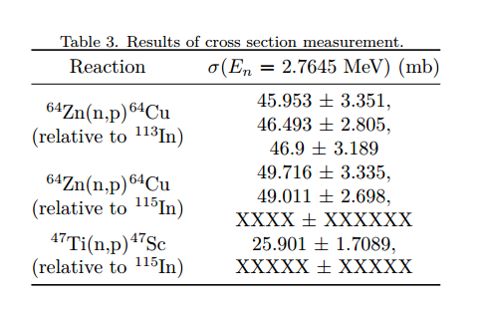
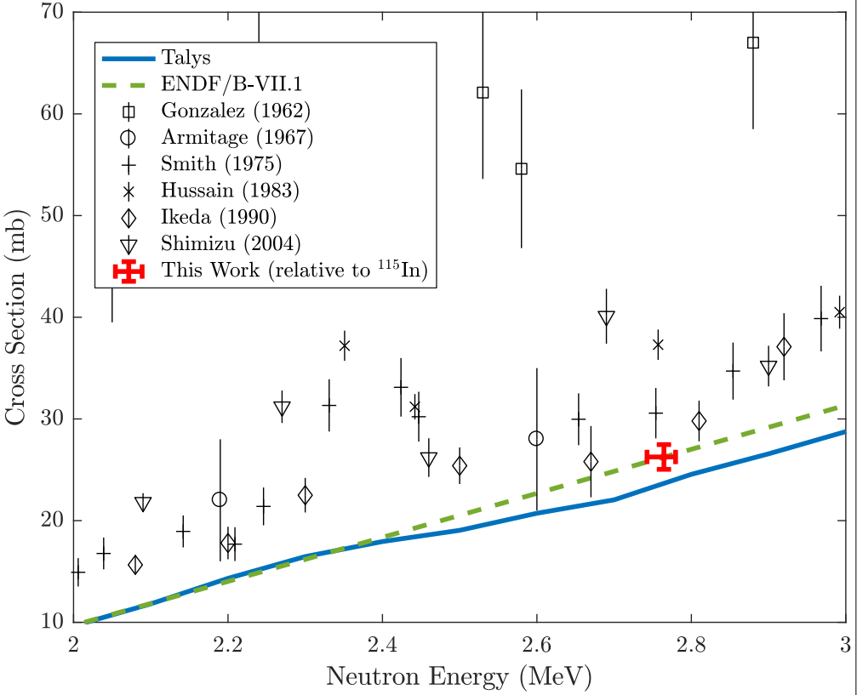
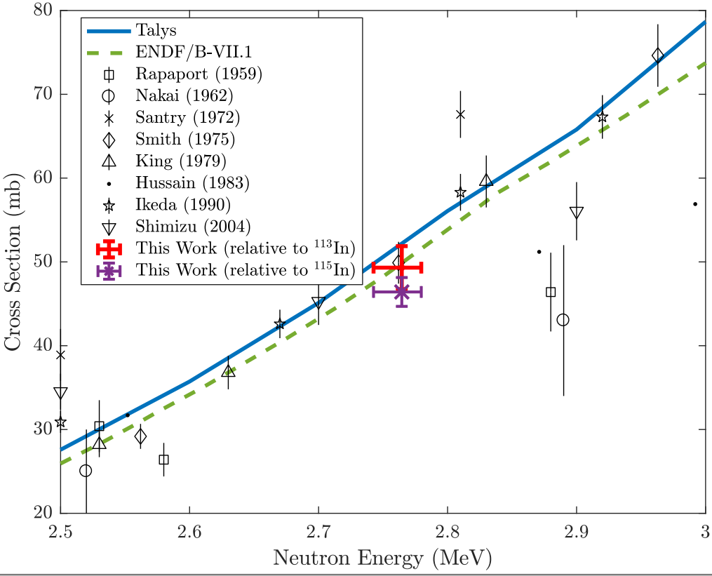
Neutron Energy Spread
⁶⁴Zn(n,p)⁶⁴Cu
⁴⁷Ti(n,p)⁴⁷Sc
⁴⁷Ti(n,p)⁴⁷Sc
“Measurement of the ⁶⁴Zn, ⁴⁷Ti(n,p) cross sections using a DD neutron generator for medical isotope studies”, Nuclear Instruments and Methods in Physics Research B 410 (2017) 230–239

Slide 27
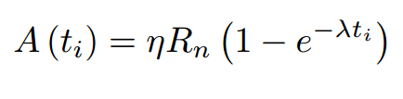
Neutron Utilization
Theoretical saturation activities are currently estimated at 1.5 kBq of ⁶⁴Cu, 0.11 kBq of ⁴⁷Sc
Characterizes the effectiveness of a neutron generator as an isotope generator
Measured production rates were 453.8 Bq of ⁶⁴Cu, 31.6 Bq of ⁴⁷Sc
Implies η ≈ 3 x 10⁻⁵ (⁶⁴Cu), η ≈ 1 x 10⁻⁵ (⁴⁷Sc)

Slide 28
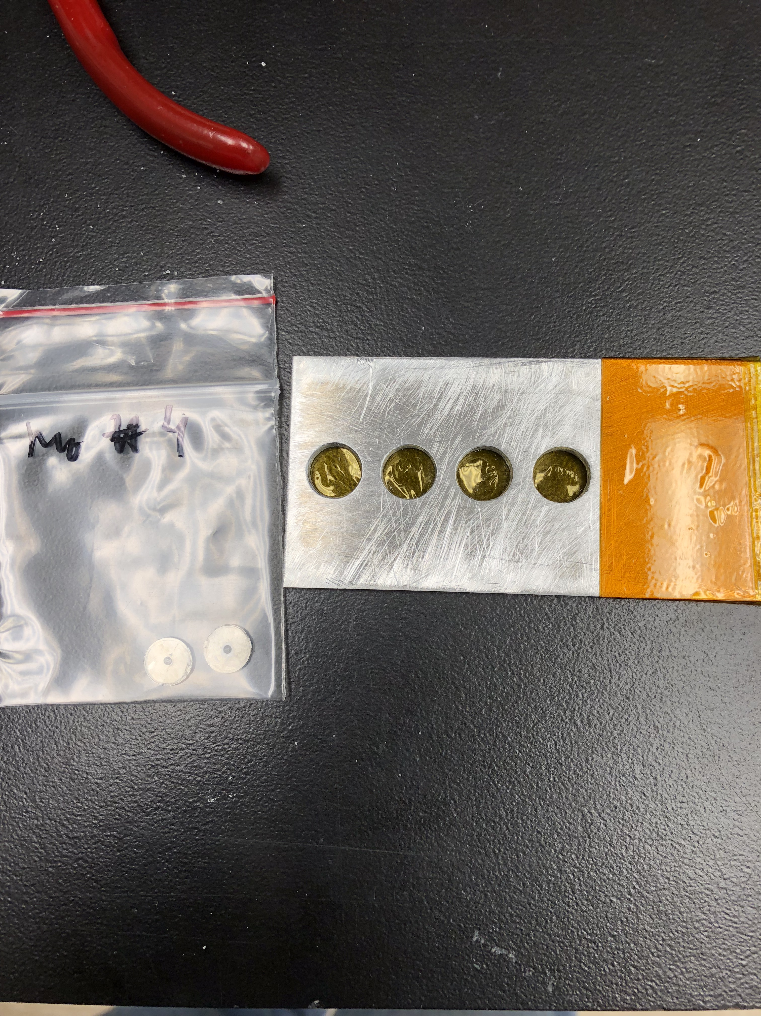
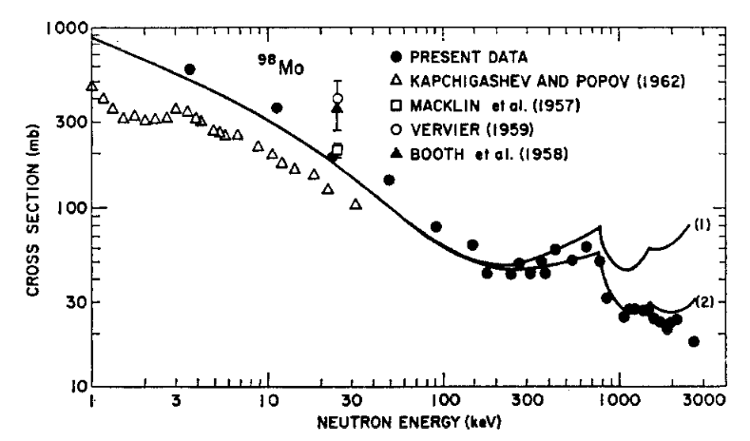
Measurement of the ⁹⁸Mo(n,γ) Cross Section
A recent experiment at the HFNG was conducted by Eric Matthews to re-measure the (n,γ) cross section of ⁹⁸Mo.
Using a custom target holder, four energy locations were measured.
This cross section has not been measured since 1967 and re-measurement of this cross section in the 1-10 MeV was marked as a vital nuclear data need in the NDNCA nuclear data needs matrix, for thermal reactor ⁹⁹Mo production.
Stupegia et al., 1967

Slide 29
Stacked-target Charged Particle Excitation Functions
___________________________
^{Low Energy – LBNL}

Slide 30
Why charged particle production?
Cyclotron
Many hospitals have small K~15 medical cyclotrons for PET tracer production
Leverage existing infrastructure
Explore higher energies for regional research cyclotrons, basic science
Linac
Commonly used for high-energy production (LANL – IPF)
Useful for anchoring to complementary low-energy measurements

Slide 31
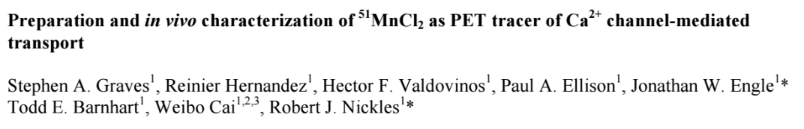
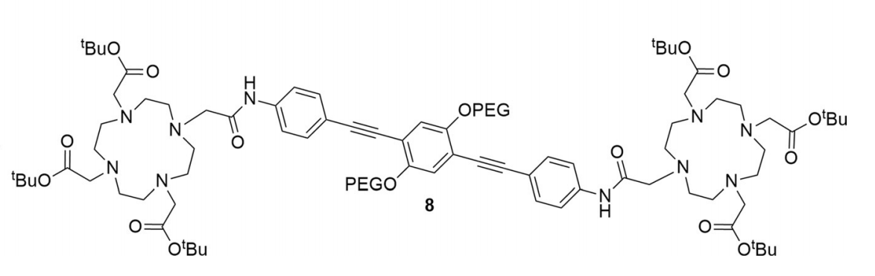
^{51,52}Mn - Motivation
Emerging medical radionuclides
⁵¹Mn (t_{1/2} = 46 min, 97% β⁺) – short-lived PET tracer for metabolic studies
^{52g}Mn (t_{1/2} = 5.6 d, 29% β⁺) – long-lived PET tracer for neuron tracking, immune studies
Manganese has well-established biochemistry and uptake via DOTA-based chelation
Almost no Fe(p,x) XS measurements exist – can use these to probe spin physics in the A≈50 region
Mn
Mn
Notes:
The four secondary amine groups are modified by replacement of the N-H centers with N-CH₂CO₂H groups. The resulting aminopolycarboxylic acid, upon ionization of the carboxylic acid groups, is a high affinity chelating agent for di- and trivalent cations.

Slide 32
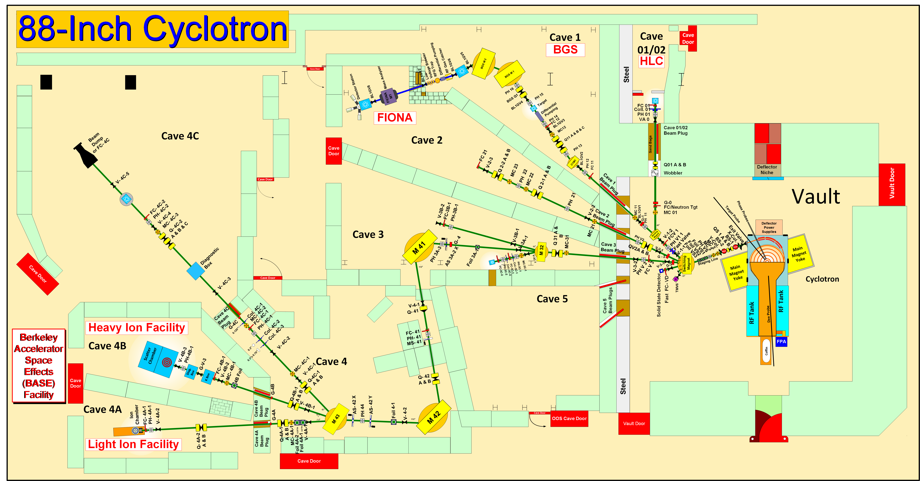
Methodology
K-140
Notes:
Cyclotron freq w = Q B / m
T = (m/2) w^2 r^2
T/A = (B r / 2 m)^2 (Q/A)^2 = K (Q/A)^2

Slide 33
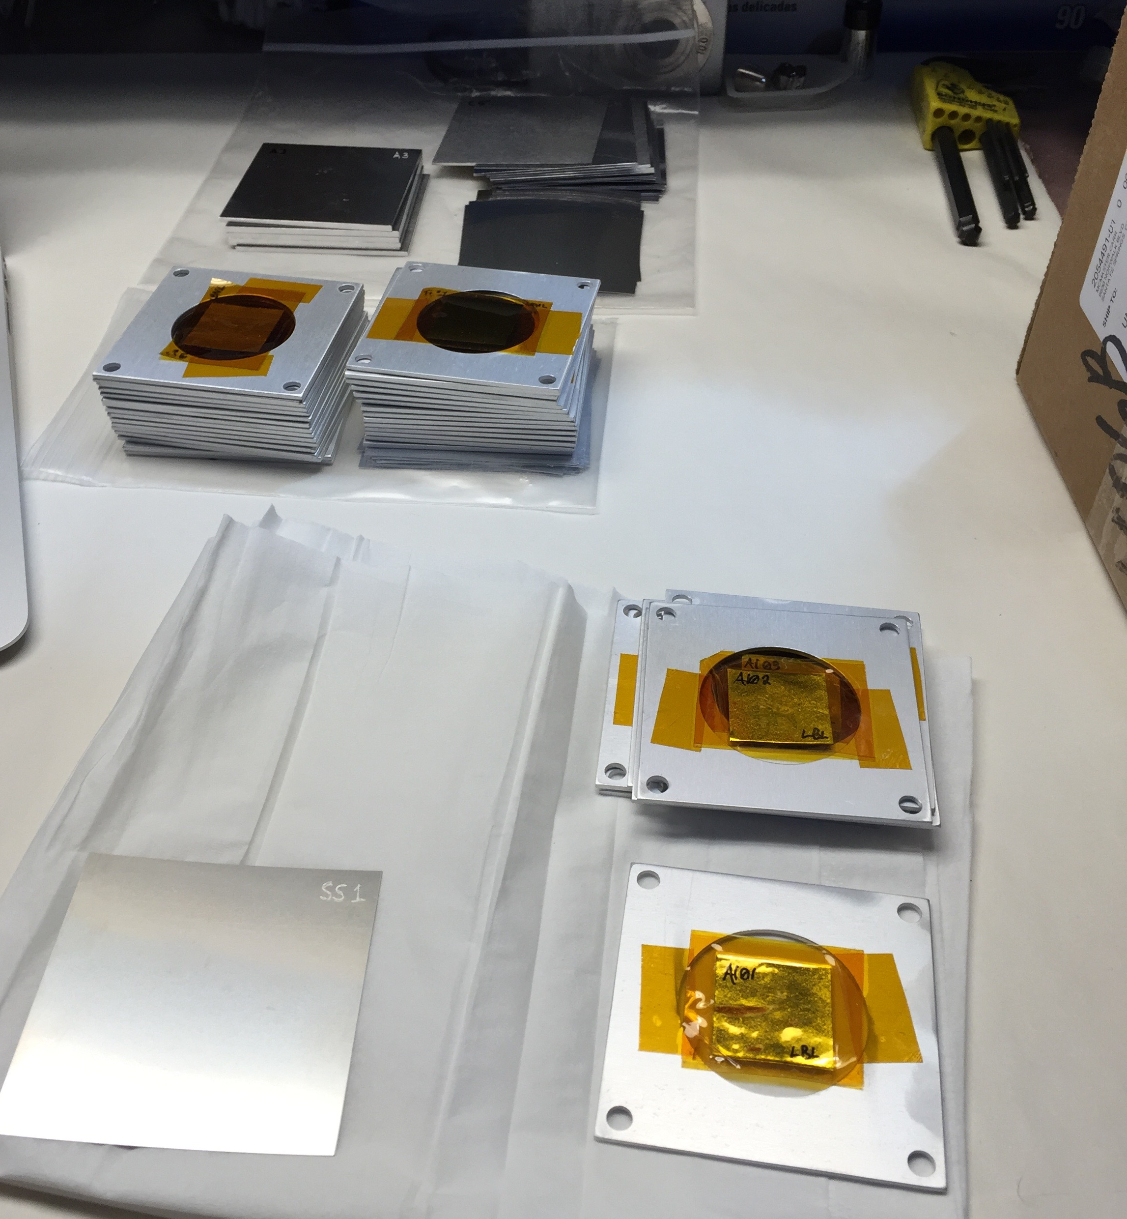
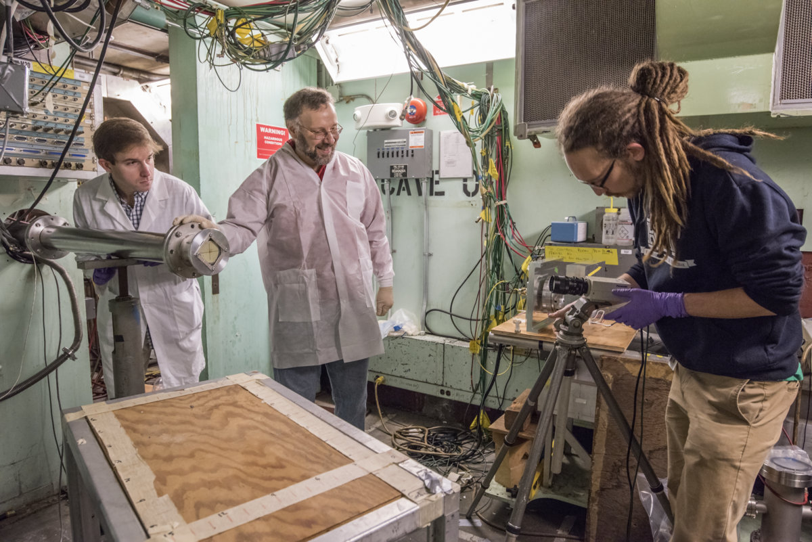
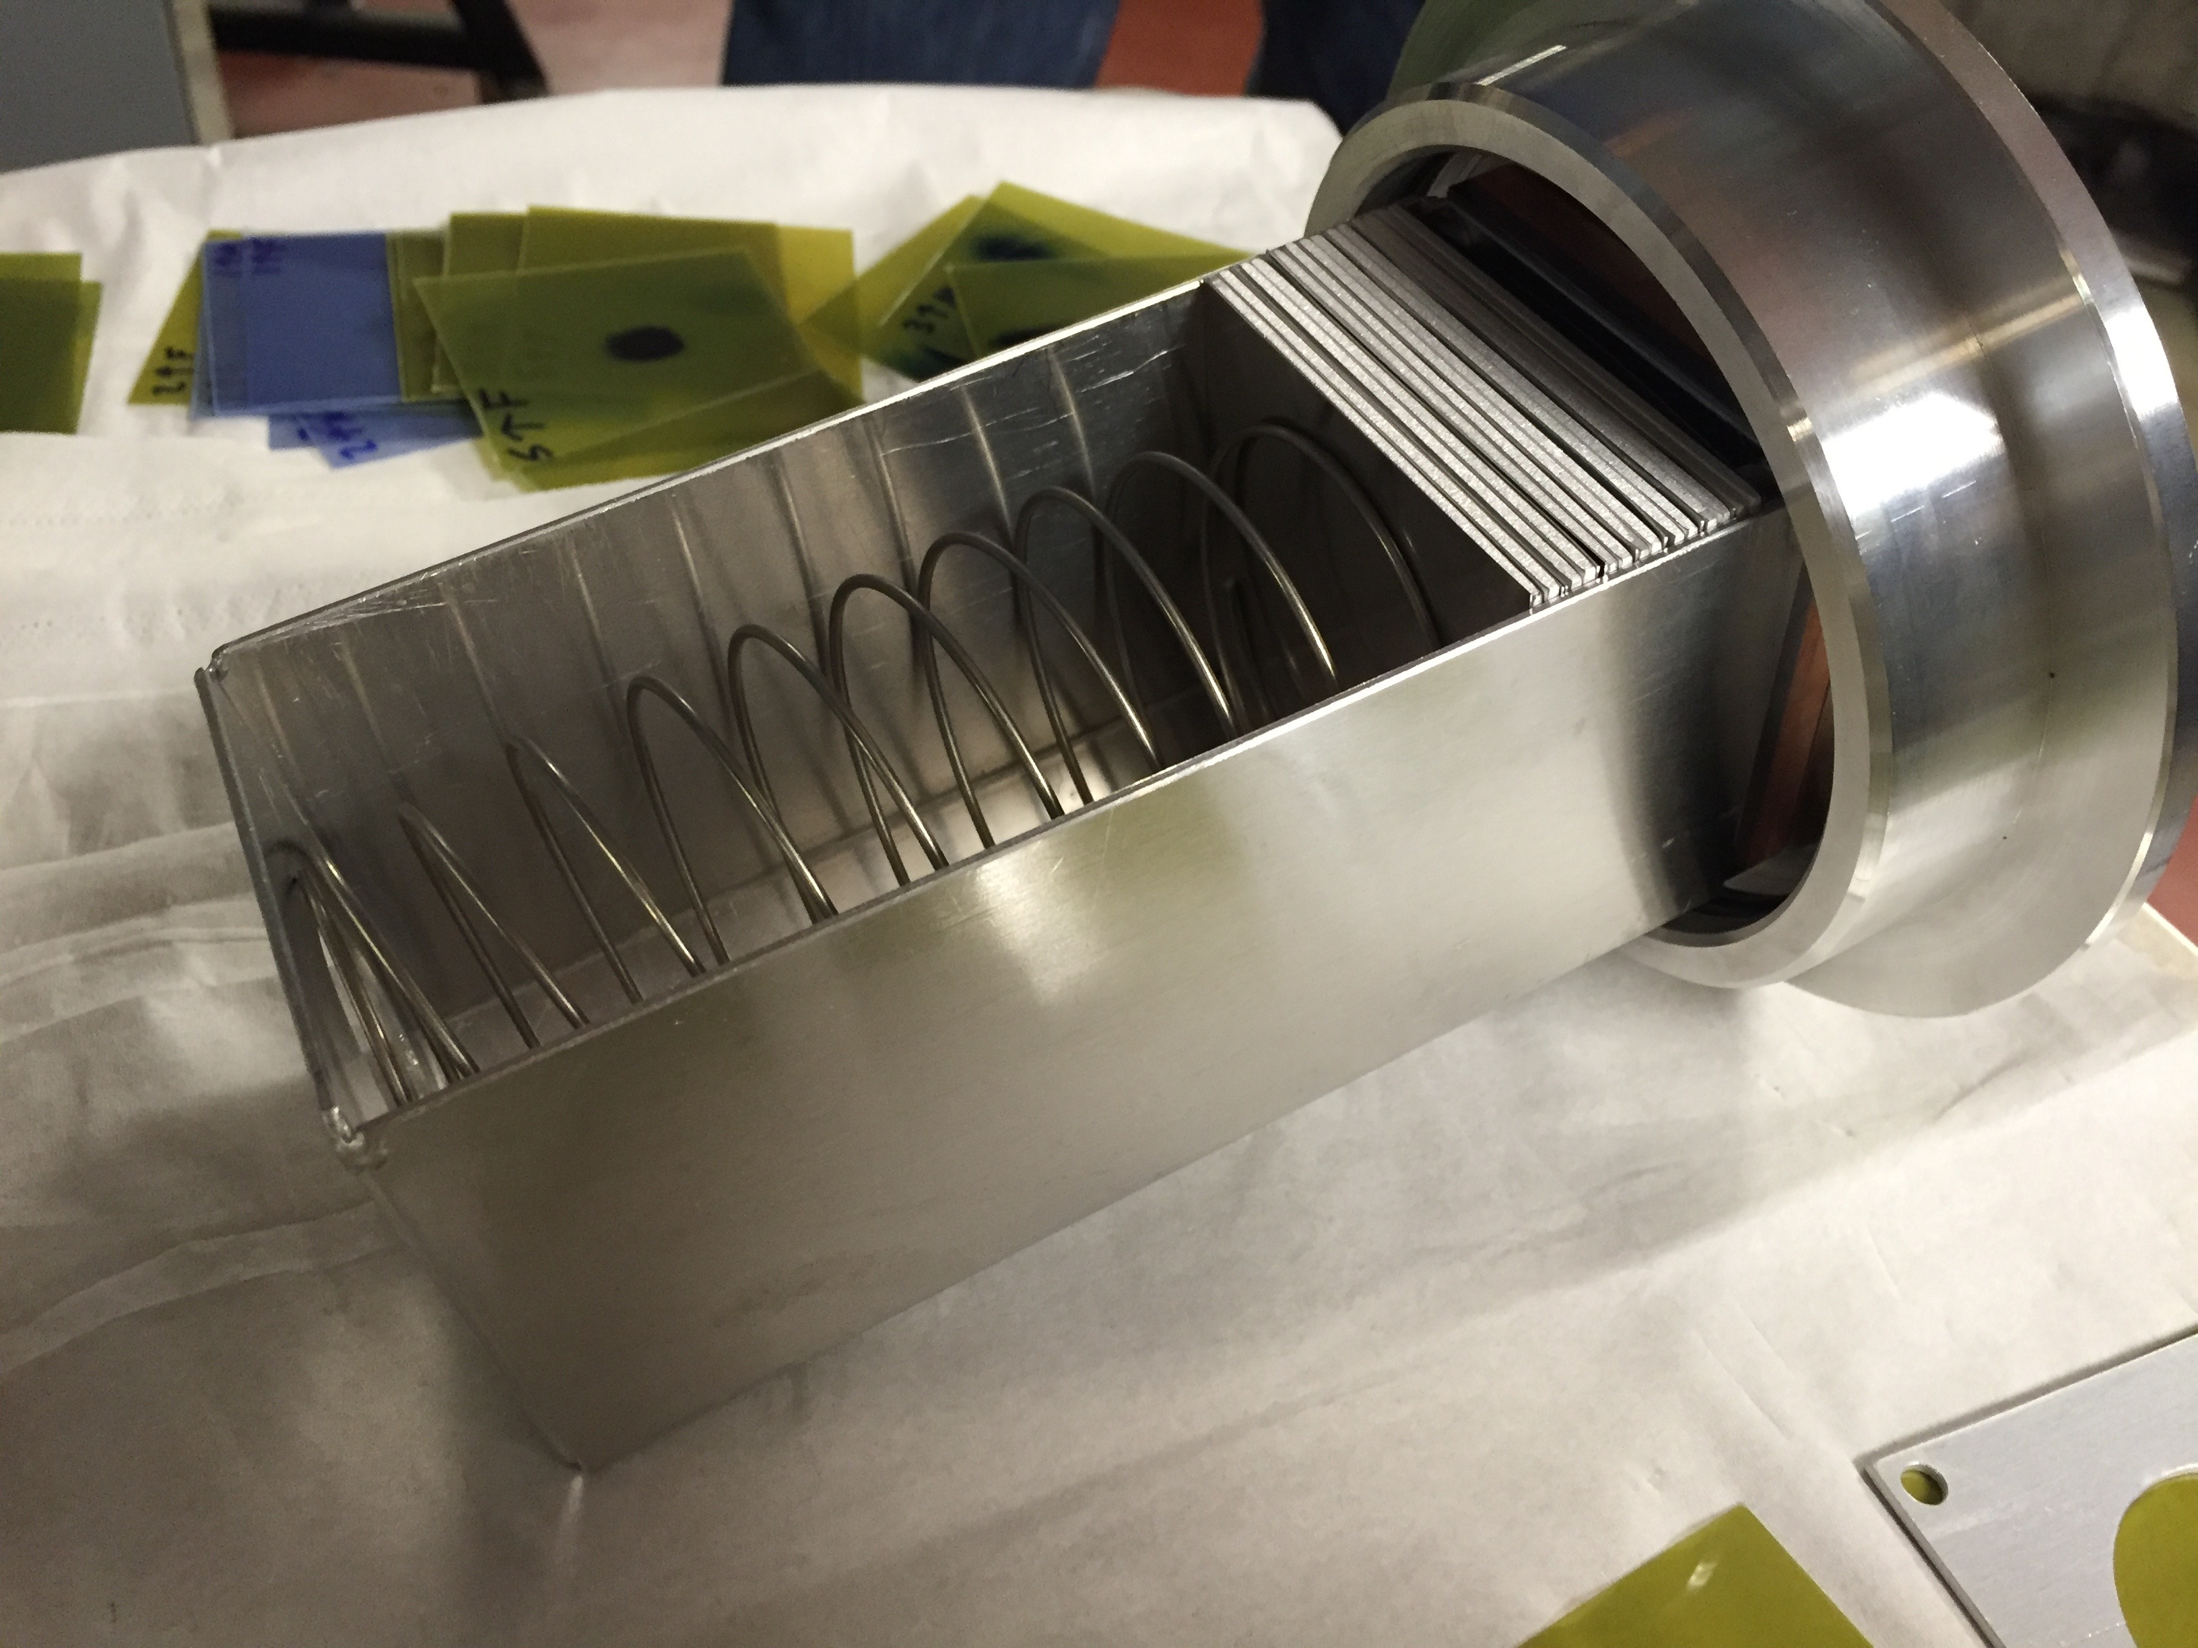
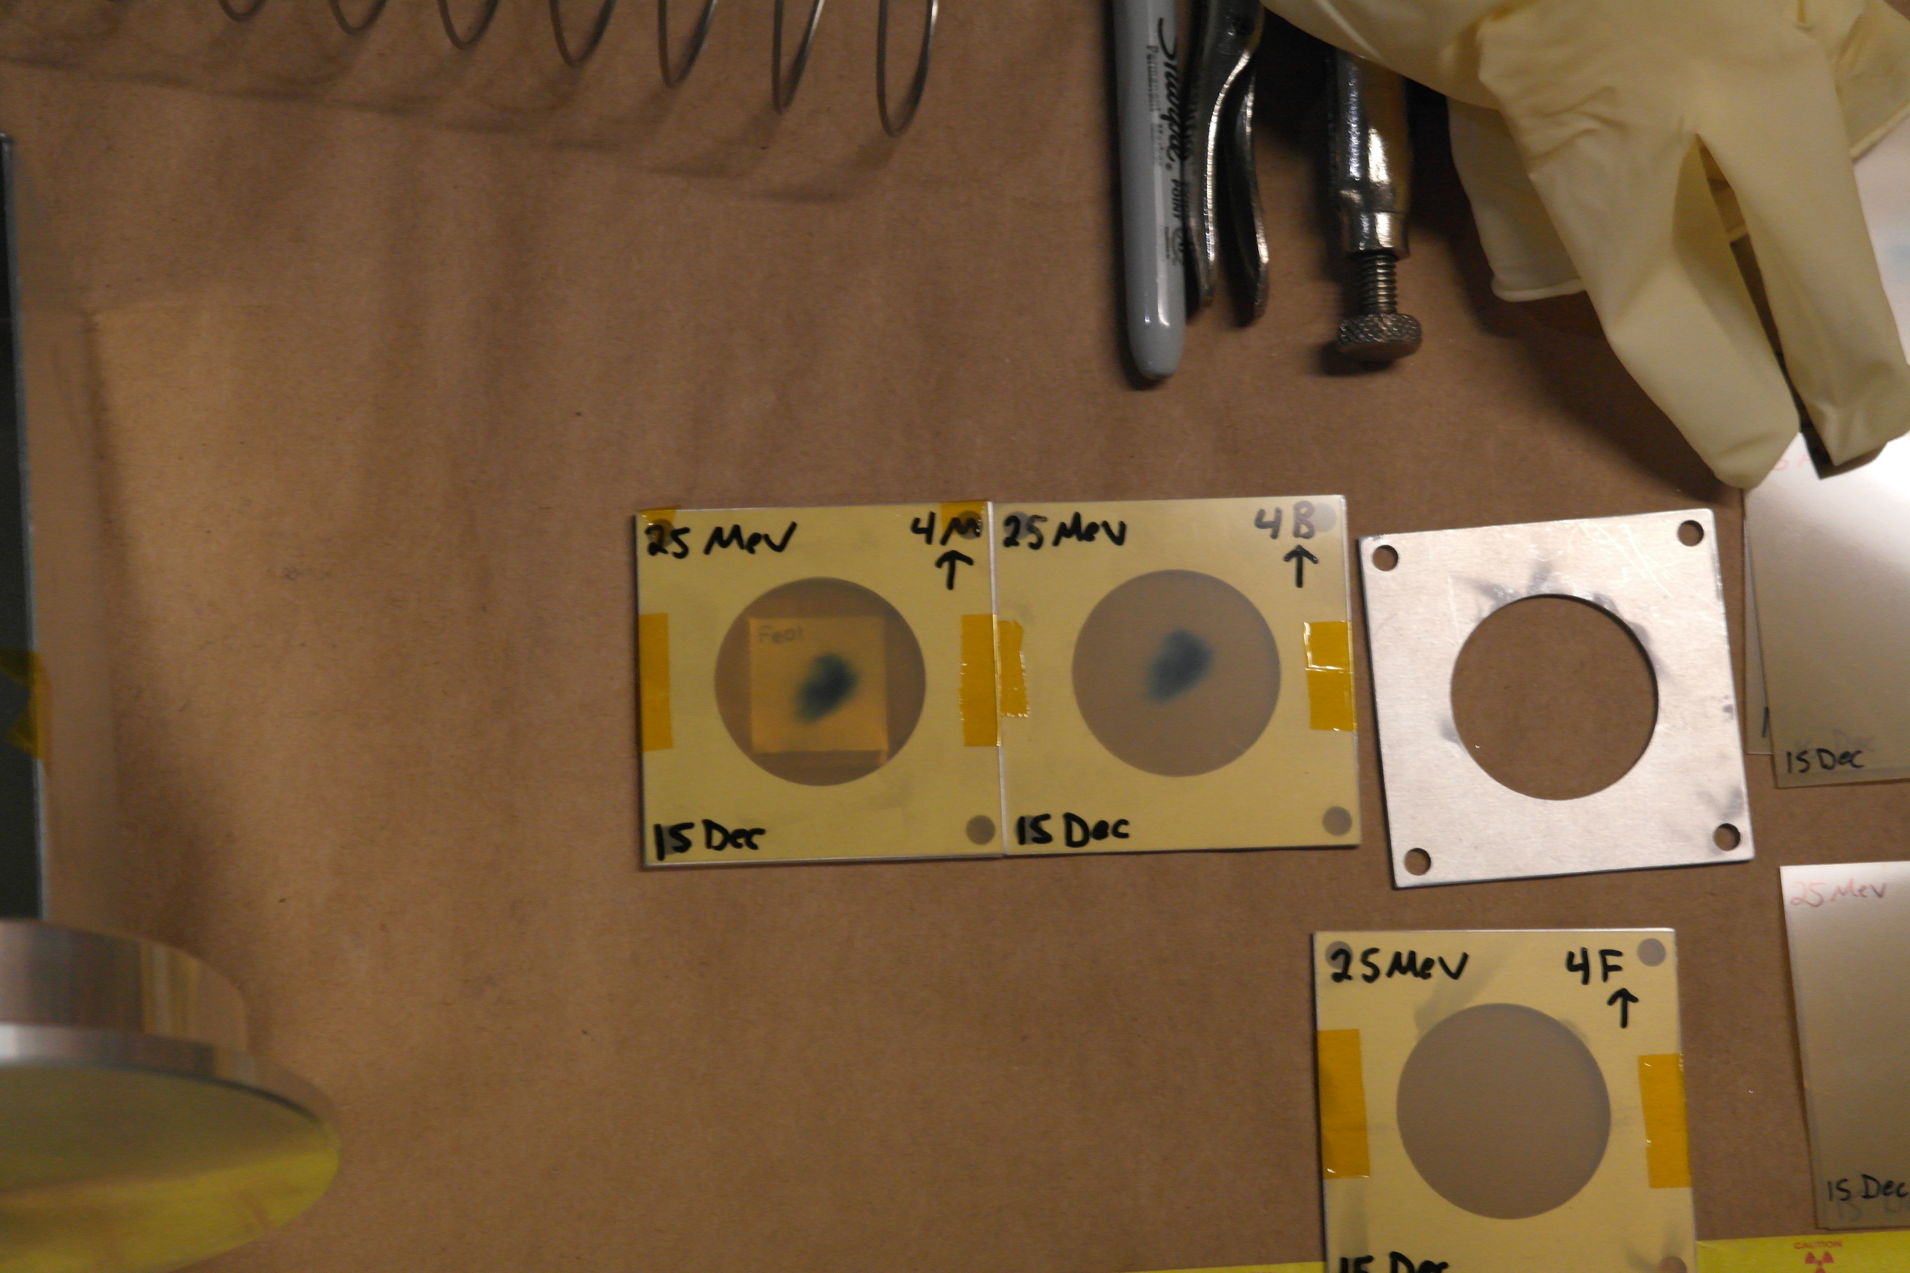
A. Springer
L. Bernstein
2.5 cm
Two overlapping stacks: E_{p}= 55→21 MeV, 25→11 MeV
(120 nA@10 min, 100 nA@20 min)

Slide 34
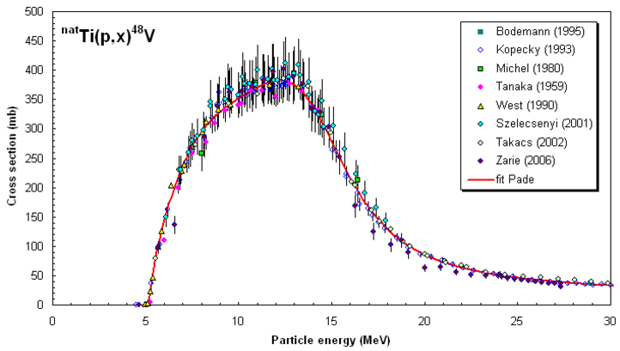
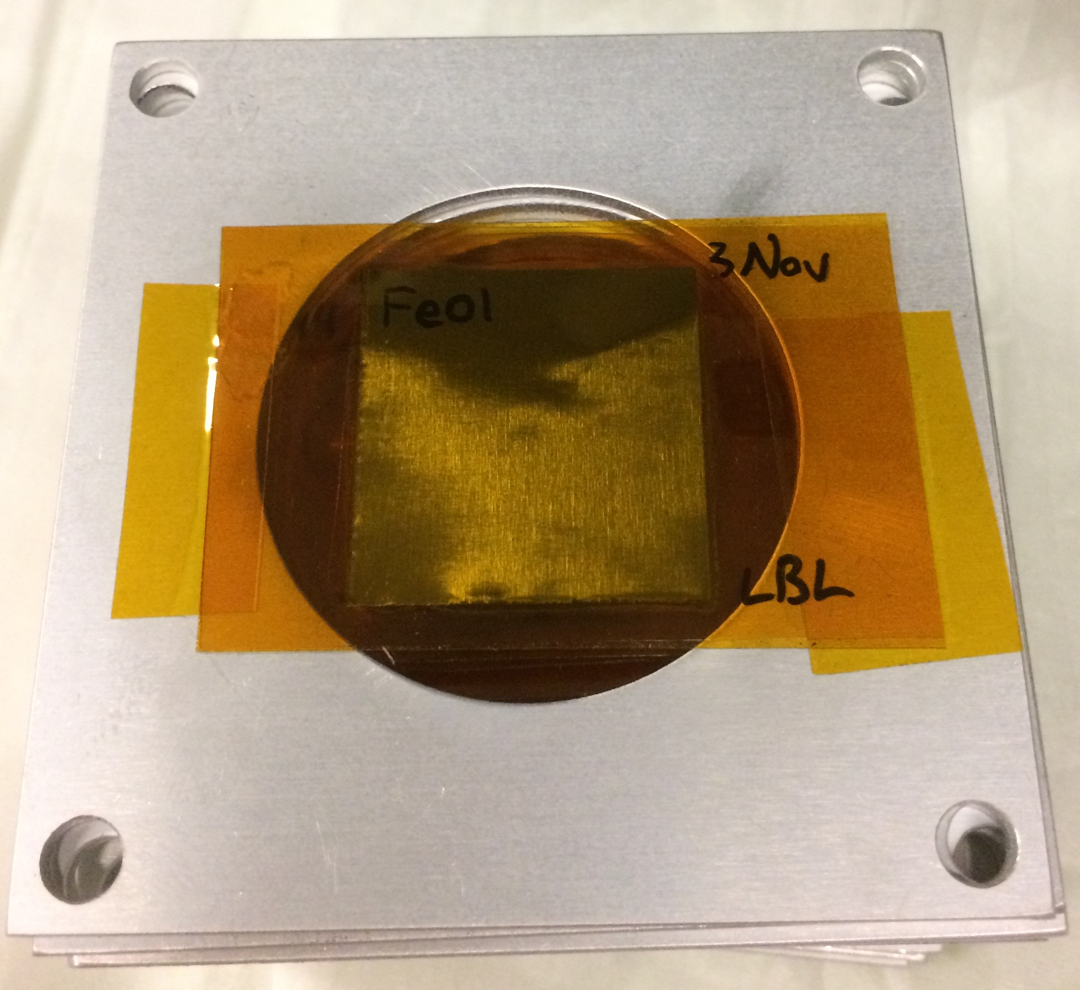
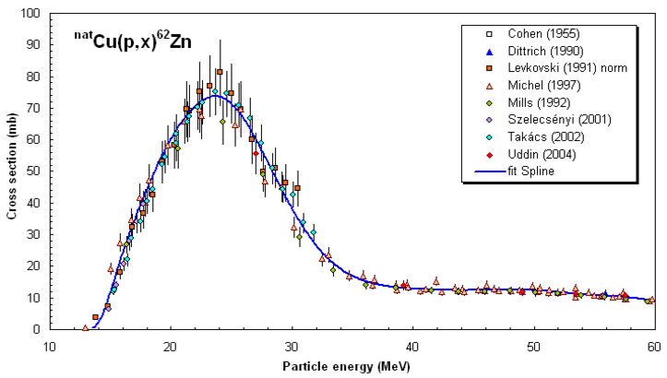
25 μm-thin ^{nat}Fe, ^{nat}Cu, ^{nat}Ti foils in 0.1” Al frames
2.5 cm
Fluence Sensitivity
Energy Sensitivity
nds.iaea.org/medical/monitor_reactions.html
Dosimetry: IAEA charged particle beam monitor reactions:
^{nat}Ti(p,x)⁴⁸V
^{nat}Cu(p,x)^{62,63,65}Zn

Slide 35
Fe(p,x)
Cu(p,x)
Ti(p,x)

Slide 36
Data Analysis Issues
Why is no activity seen in Ti20 / Cu20?

Slide 37
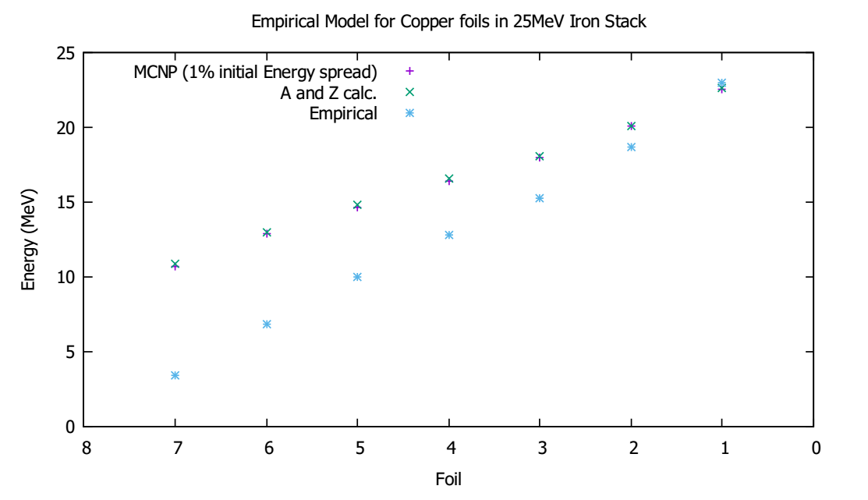

Notes:
Monitor foils as “canary in the coal mine”

Slide 38
Corrected Energy Assignments
Silicone Adhesive
Kapton
38 μm @1.18 g/cm³ = 4.48 mg/cm²
25 μm @1.42 g/cm³ = 3.55 mg/cm²
Activation Foil
25 μm = 11 - 23 mg/cm²
Silicone Adhesive
Kapton
25 μm @1.42 g/cm³ = 3.55 mg/cm²
38 μm @1.18 g/cm³ = 4.48 mg/cm²

Slide 39

Corrected Energy Assignments

Slide 40

LANL sees the same issue…
S. A. Graves, P. A. Ellison, T. E. Barnhart, H. F. Valdovinos, E. R. Birnbaum, F. M. Nortier, R. J. Nickles, and J. W. Engle, Nucl. Instruments Methods Phys. Res. Sect. B Beam Interact. with Mater. Atoms, vol. 386, pp. 44–53, Nov. 2016.

Slide 41

Corrected Energy Assignments
Goal: Minimize standard deviation of

Slide 42

Preliminary
Using current from charge integrator
Notes:
Discrepancy possible causes :
Still using current from charge integrator, once energy assignment is finished, monitor foils will provide renormalization to true current
Direct production of 51Cr creates “extra” cross section
Low peak is 54Fe(p,x), high peak is 56Fe(p,x)

Slide 43



Slide 44
Preliminary

Slide 45
Preliminary
Results consistent with R≈1 at high energy.
At low energy, results are ambiguous due to energy straggling.

Slide 46
Spin Distribution Application
Through its impact on nuclear level densities, the spin cut-off parameter has a strong impact on the favoring of higher-spin isomers in charged particle-induced reactions – a “tuning parameter” for isomer-to-ground state branching ratio
Reaction physics codes can be used to model (σ_{m}/σ_{g}) when experimental data is unavailable
Case study: ¹⁷⁷Lu
^{177g}Lu (t_{1/2} = 6.7 d) – emerging β⁻ therapy agent
^{177m}Lu (t_{1/2} = 160 d) – contributes extra dose to patient, without therapeutic or diagnostic benefit
Improved spin distribution measurements can improve modeling to guide production studies

Slide 47
Stacked-target Charged Particle Excitation Functions
___________________________
^{Moderate Energy – LANL}

Slide 48
Measurements @ LANL – Nb(p,x)
^{nat}Nb(p,4n)⁹⁰Mo is a high-priority objective as a new proton beam dosimetry standard for E_{p} ≈ 50 – 100 MeV
Other emerging radionuclides: ^{82m}Rb, ⁸⁶Y, ⁸⁹Zr, ⁹⁰Nb
Z
ε+β⁺ |  |  | ⁹⁰Mo |  |  | ^{93m}Mo | ⁹⁴Mo
IT |  |  | ^{89m}Nb ⁸⁹Nb | ⁹⁰Nb | ^{91m}Nb | ^{92m}Nb | ⁹³Nb
 | ⁸⁶Zr | ⁸⁷Zr | ⁸⁸Zr | ⁸⁹Zr
 | ^{85m}Y ⁸⁵Y | ⁸⁶Y | ^{87m}Y ⁸⁷Y | ⁸⁸Y
⁸³Sr |  | ^{85m}Sr
^{82m}Rb |  |  |  |  |  |  |  | β⁻
^{100 MeV} ^{p+}
N

Slide 49

Measurements @ LANL – Nb(p,x)
IPF
Proton Injectors
201.25 MHz Drift Tube Linac
p+
805 MHz Side-Coupled Cavity Linac
To research centers
p+
p-
800 m
p-
750 keV
100 MeV
800 MeV
h+

Slide 50




Measurements @ LANL – Nb(p,x)
LBNL: 5 – 55 MeV / A, LANL: 45 – 100 MeV p⁺
Complementary measurements explore reaction dynamics in different energy regimes, overlap region of 45-55 MeV builds confidence and consistency in results.
M. Nortier
^{100 nA @ 3 hr}
^{100 MeV p+}

Slide 51
Measurements @ LANL – Nb(p,x)

Slide 52
Measurements @ LANL – Nb(p,x)
1894 unique peaks across 107 spectra

Slide 53



Better consistency…but why is ²²Na so high?

Slide 54
It’s always the Kapton!
Kapton
25 μm @1.42 g/cm³ = 3.55 mg/cm²
Silicone Adhesive
38 μm @1.18 g/cm³ = 4.48 mg/cm²
Activation Foil
25 μm = 11 - 23 mg/cm²
Silicone Adhesive
38 μm @1.18 g/cm³ = 4.48 mg/cm²
Kapton
25 μm @1.42 g/cm³ = 3.55 mg/cm²

Slide 55



Slide 56



Measurements @ LANL – Nb(p,x)
38 measurements of cross-sections for ⁹³Nb(p,x) and ^{nat}Cu(p,x)
A.S. Voyles et al., “Measurement of nuclear excitation functions for proton induced reactions (E_{p} = 40 – 90 MeV) on natural Nb and Cu”, PRC 2018 (in preparation)

Slide 57

Measurements @ LANL – Nb(p,x)
5 independent measurements of isomer-to-ground state ratios
A. Lewis

Slide 58


Demonstrated ability to measure excitation functions for emerging medical radionuclides through 3 different production paradigms
Provides first / vastly improved production measurements for each of the isotopes listed here
Thin-target measurements in this work provide an ideal jumping-off point to begin thick-target yields for commercial application, as well as radiochemical workup
G. Henriksen
S. Siem
B. Schoultz

Slide 59


Path Forward: ²³⁸U(p,xn)^{236,237}Np and ²³⁵U(d,x)²³⁶Np Production
green x=1
brown x=3
blue x=4
Literature reaction cross sections for ²³⁸U(p, xn)
Vital mass-spec “spike” for nonproliferation

Slide 60

Path Forward: ⁷Li(p,n) “Quasi-Monoenergetic” Neutron Source
Vault-based irradiation
Inconel-clad Li targets
(LANL LDRD)
0°
-20°
Unreacted protons
Li(p,n) neutron
production target
Jon Engle
Neutrons from 0-60 MeV
Samples irradiated in the vault
Unreacted beam dumped in Cave 0
Flux from 10⁶⁻⁴ /MeV/sr/s (decreases w/E_{n})
First experiments are planned for April 2018
Notes:
This is the same method used at the new FRANZ facility in Frankfurt.

Slide 61


Path Forward: ¹⁴⁰La(p,6n)¹³⁴Ce as a PET tracer for ²²⁵Ac
Stacked Target Holder
¹⁴⁰La(p,6n)¹³⁴Ce Cross Section
Preliminary
Jon Morrell
HPGe counter
Investigating potential for ²²⁶Ra(2,2n)²²⁵Ra → ²²⁵Ac
Kratochwil, Clemens, et al. "225Ac-PSMA-617 for PSMA-targeted α-radiation therapy of metastatic castration-resistant prostate cancer." Journal of Nuclear Medicine 57.12 (2016): 1941-1944.
Notes:
3x 9 MBq dose fractions

Slide 62
Collaborators on this work
M.S. Basunia¹, J.A. Batchelder², J.D. Bauer³, T.A. Becker⁴, L.A. Bernstein^{1,2}, E.R. Birnbaum⁵, J.W. Engle^{5,6}, R.B. Firestone¹, S.A. Graves⁷, G. Henriksen⁸, A.M. Hurst¹, L. Kirsch³, A.M. Lewis², E.F. Matthews², F.M. Nortier⁵, S.M. Qaim⁹, P.R. Renne⁴, D. Rutte⁴, B.W. Schoultz¹⁰, S. Siem¹¹, A. Springer¹², M.A. Unzueta², K.A. Van Bibber², A.S. Voyles², C.S. Waltz³ H. Zaneb¹³
¹ Lawrence Berkeley National Laboratory
² University of California-Berkeley Dept. of Nuclear Engineering
³ Lawrence Livermore National Laboratory
⁴ Berkeley Geochronology Center
⁵ Los Alamos National Laboratory
⁶ University of Wisconsin – Madison
⁷ University of Iowa – Department of Radiation Oncology
⁸ University of Oslo – Institute of Basic Medical Sciences
⁹ Forschungszentrum Jülich
¹⁰ University of Oslo – Department of Chemistry
¹¹ University of Oslo – Department of Physics
¹² Karlsruhe Institute of Technology
¹³ University of Lahore

